Slide 2
PMS Study Results
vakgroep < ... >
onderzoeksgroep < ... >
Mitchel Kappen, ISALA, Tilia Linthout, Liese Opsomer, Sofie Raeymakers, Steven Weyers, Marie-Anne Vanderhasselt
Notes:
Hello everyone! Today Mitchel and I are presenting you the first results of the data analysis of the PMS study

Slide 3
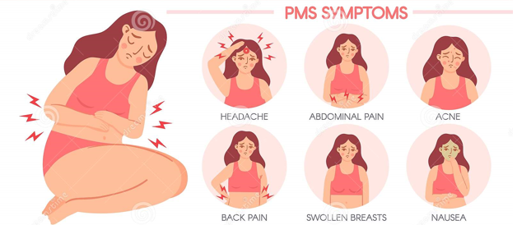
PMS
Mood swings
Anxiety
Tiredness
diarrhea
Bloating
Appetite
Sex drive
…
Notes:
Let me first introduce you to what this study is about.
PMS or Premenstrual Syndrome, is a disorder exclusive to people who have their periods. People who have PMS get a range of symptoms such as mood swings, anxiety, tiredness, sleep problems, abdominal pain and bloating, tender breasts, headaches, spotty skin and changes in appetite and sex drive, and lower serotonin levels. The etiology and symptoms of PMS and depression have been linked together as well.

Slide 4
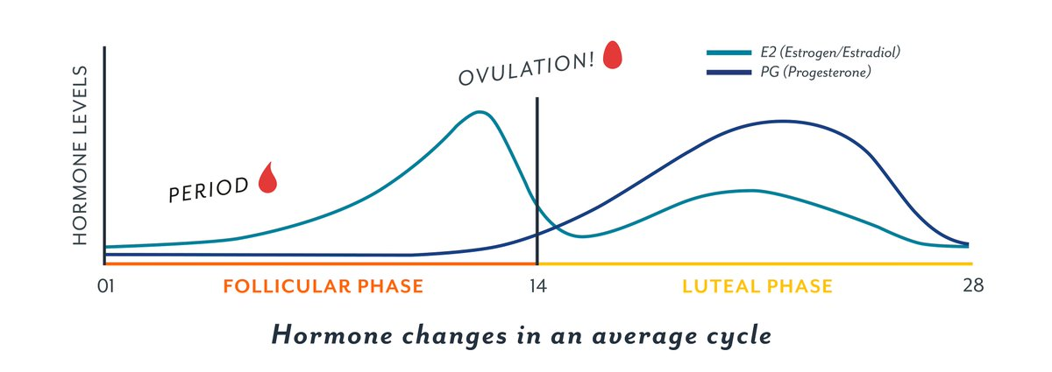
HelloClue (2020). https://twitter.com/clue/status/1000082320081076225
Notes:
As the name suggests, this happens before menstruation, during the luteal phase. Symptoms disappear 1-2 days into menstruations.

Slide 5
Prevalence
75%: some symptoms
20-30%: moderate to severe (!)
5-8%: Premenstrual Dysphoric Disorder (PMDD). Severe PMS symptoms, recently added to the DSM: more attention to PMS symptoms
¹ Landén, M., & Eriksson, E. (2003). How does premenstrual dysphoric disorder relate to depression and anxiety disorders? Depression and Anxiety, 17(3),
122–129. https://doi.org/10.1002/da.10089.
² Grady-Weliky, T. A. (2003). Premenstrual Dysphoric Disorder. New England Journal of Medicine, 348(5), 433–438. https://doi.org/10.1056/NEJMcp012067
³ Ussher, J. M. (2014). Premenstrual syndrome. Cambridge Handbook of Psychology, Health and Medicine, 830–832. https://doi.org/10.1017/CBO9780511543579.217
Notes:
The prevalence of such PMS symproms is quite high. About 20 to 30 percent of the menstruating population has moderate to severe symptoms, which is quite a lot. And about 5-8 percent falls within the category of PMDD or Premenstrual dysphoric disorder, which has recently been added to the DSM. This signals an increased interest in researching the topic of PMS, which has untill now been an underdeveloped research topic.

Slide 6
Questions
PMS vs no PMS
During follicular and luteal(premenstrual) phase cycle:
Higher stress/rumination?
Emotion:
- explicit: self-report - implicit: emotional expressions
Notes:
In this study, the question was wether or not people with PMS have higher stress, more rumination and more negative responses than people without PMS, as well as if there is a difference depending on wether we measure this during the premenstrual or luteal phase or during the follicular phase. The follicular phase is the phase after menstruation and before ovulation.

Slide 7
methods

Slide 8
Participants
398 recruited
Invitation via email, execution on LimeSurvey + 24 h reminder
Healthy, 18-45 yo
Menstruating with regular cycle
Exclusion: - pregnant/ breastfeeding
- hormones/ hormonal intrauterine device: (118 ppt)
- BSRI = 0 (2 ppt)
=> 279 ppt
Notes:
We managed to recruit 398 participants. The study was conducted via LimeSurvey. All participants were healthy 18-45 year olds with a regular menstruation cycle. We excluded pregnant or breastfeeding participants, as well as those on hormones.

Slide 9
3 Testmoments
Intake/screening: social demographics, menstrual cycle, contraception methods, PSST + trait questionnaires (DASS)
TestMoment 1 + 2 (follicular & luteal/premenstrual): PSS(stress), BSRI(rumination), rate pictures + webcam recording
Notes:
There were three testmoments, all of them online via LimeSurvey. We first did an intake/screening where we recorded some social demographics, menstrual cycle, contraception methods, PSST (which is a measure of PMS symptoms), and trait questionnaires such as the DASS.
Then during testmoment 1 and 2, respectively during the folluclar and luteal or premenstrual phase, we let participants fill in the PSS and BSRi questionnaires after which they had to rate pictures on valence and arousal while their faces were recorded via their webcam.

Slide 10
screening
Wat is uw geslacht? Man/Vrouw
Wat is uw leeftijd? xx jaar
Op welke leeftijd werd u voor het eerst ongesteld? xx jaar
Heeft u een regelmatige mentruatiecyclus? Ja/Nee
Bent u in de menopauze of deze al gepasseerd? Ja/Nee
Bent u op dit moment zwanger of borstvoeding aan het geven? Ja/Nee
Gebruikt u hormonale contraceptie? Ja/Nee
Indien ja, welke en met welke dosis
Is Nederlands uw moedertaal? Ja/Nee
Indien nee, hoe goed is uw beheersing van de taal? Zwak, Matig, Goed, Zeer Goed
Neemt u een vorm van hormonen op dit moment? Ja/Nee
Zo ja, welke en met welke dosis
Lijdt u op dit moment aan een mentale of somatische stoornis? Ja/Nee
Bent u in het bezit van een computer/laptop met webcam? Ja/Nee
Ingebouwde webcam bovenin is ook in orde
Welke dag eindigde uw laatste menstruatie?
Welke dag startte uw laatste menstruatie?
Hoeveel dagen is uw menstruatiecyclus gemiddeld?
Notes:
Here is some example of the screening. We did this to ensure that participants fell within the inclusion criteria. They had to be dutchspeaking, have regular cycles and not be on hormones.

Slide 11
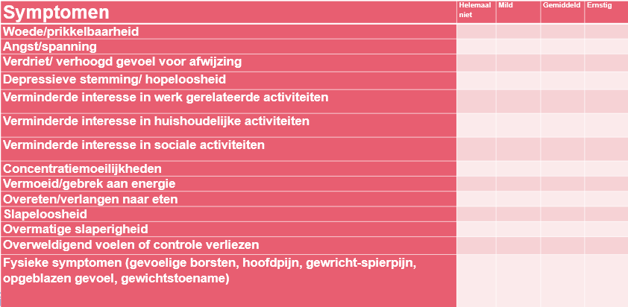
PSST
Premenstrual Symptoms Screening Tool
Currently most reliable
Steiner et al., 2003b
Notes:
The PSST is a tool for screening Premenstrual symptoms. It is currently the most reliable

Slide 12
groups
Using PSST, three groups: no PMS, PMS and ‘PMDD’
- Prevalence study matched that of general population
PMDD can only be diagnosed by psychiatrist!
=> 2 groups: no PMS & PMS symptoms
Notes:
The PSST gives us three groups: those with mild PMS symptoms, moderate to severe symptoms and then PMDD levels. The prevalence of these groups within our study matched that of the general population. Because PMDD can only be diagnosed by a psychiatrist we brought these down to two groups, one with no or mild PMS and with PMS.

Slide 13
PSS: Perceived Stress Scale
Notes:
Now we will look at PSS, which is a self-report scale for stress

Slide 14
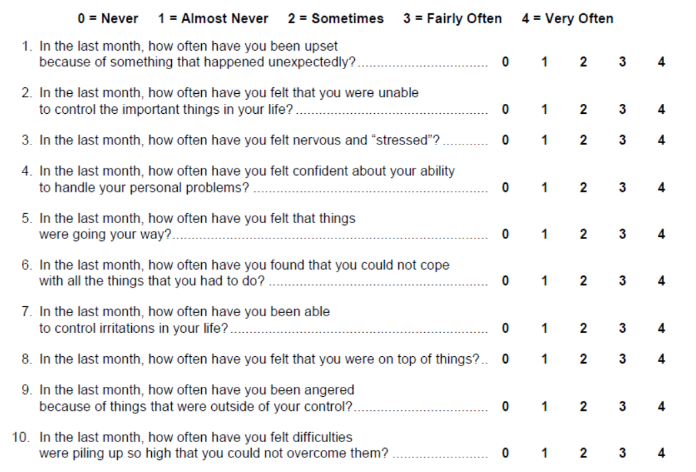
Cohen, S. and Williamson, G. Perceived Stress in a Probability Sample of the United States. Spacapan, S. and Oskamp, S. (Eds.) The Social Psychology of Health. Newbury Park, CA: Sage, 1988.
Notes:
The scale exists of 10 questions, some of which are reverse-loading.

Slide 15
Analysis
- Fitting different (G)LM to data, lowest AIC wins
- Anova & Emmeans
- Alpha= 0.05
Notes:
We fitted different General linear models to the data and took the model with the best fit to conduct an anova…

Slide 16
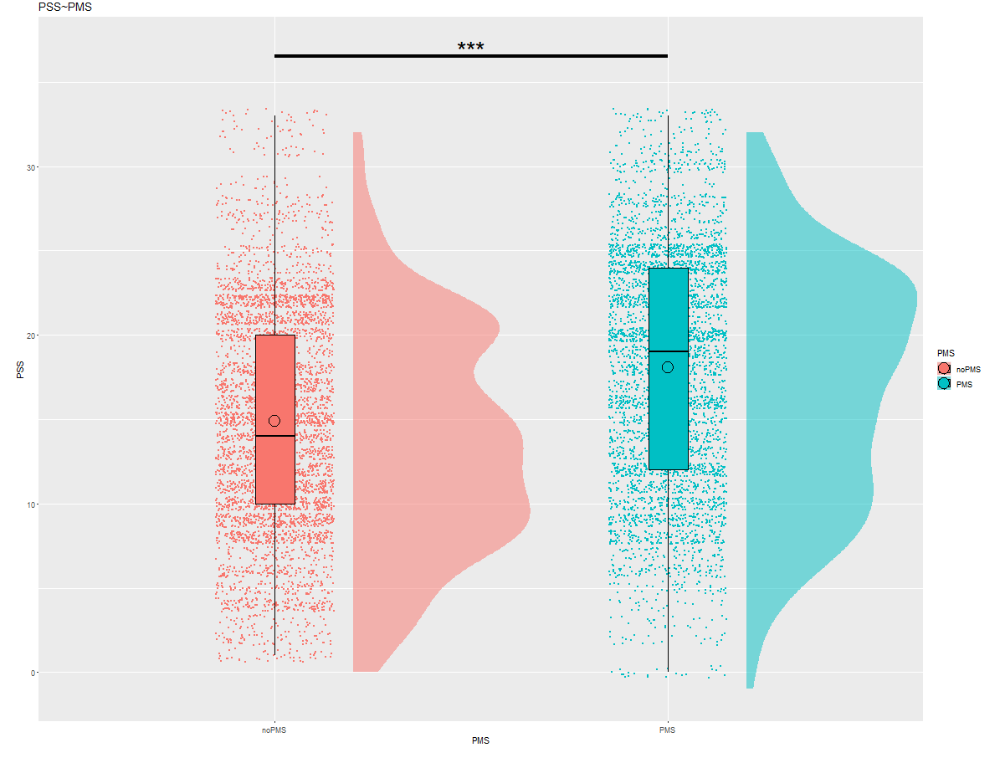
PSS
N=279
b=-3.36, SE=0.7, p<.0001
no PMS PMS
Notes:
We found a significant difference between the noPMS and pMS group, with the PMS group having more stress

Slide 17
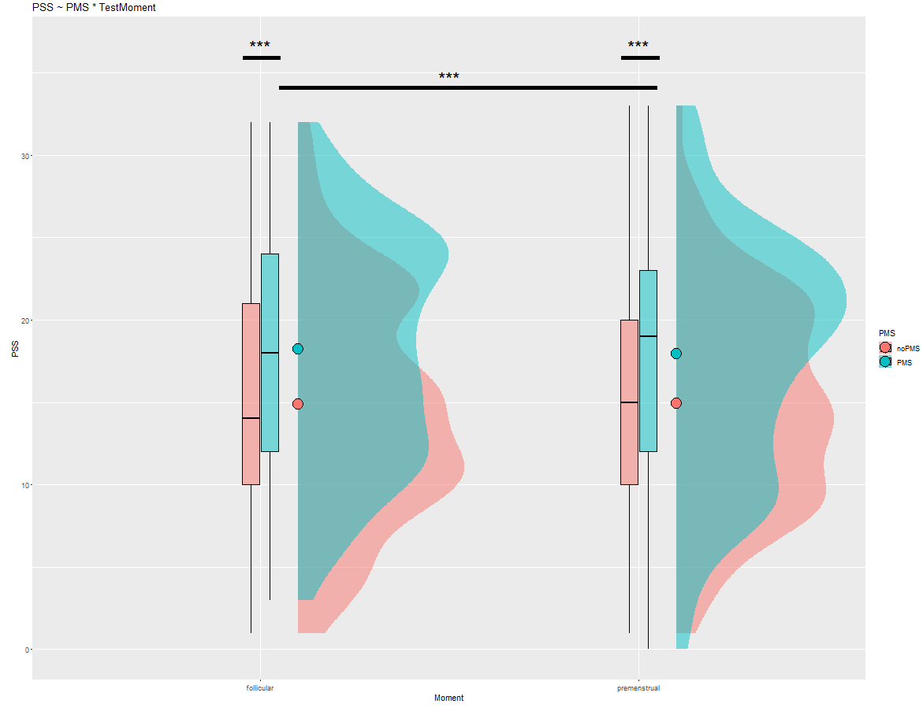
N=279
b=-0.26, SE=0.11, p-value=0.024
follicular luteal/premenstrual
Notes:
We still find this difference when controlling for testmoment.
We also see a significant difference between PMS in follicular and in premenstrual phase, with the people with PMS having higher stress scores in the premenstrual phase, which is when they would be having their PMS symptoms
PMS1-PMS2: b=-0.26, SE=0.11, p-value=0.024

Slide 18
Brief State rumination index
Notes:
Now we will look at the self-reports on the BSRI scale which measures rumination

Slide 19
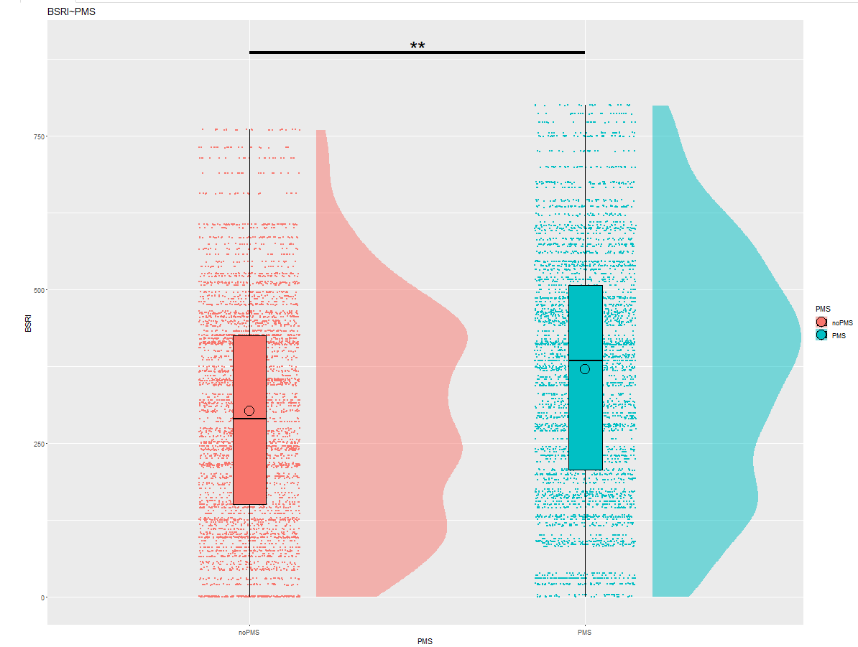
BSRI
N=279
b= -73.5, SE=19.4, p-value= 0.0002
no PMS PMS
Notes:
We found that people with PMS score higher on this scale than people without PMS
PMS > no PMS
b= -73.5, SE=19.4, p-value= 0.0002

Slide 20
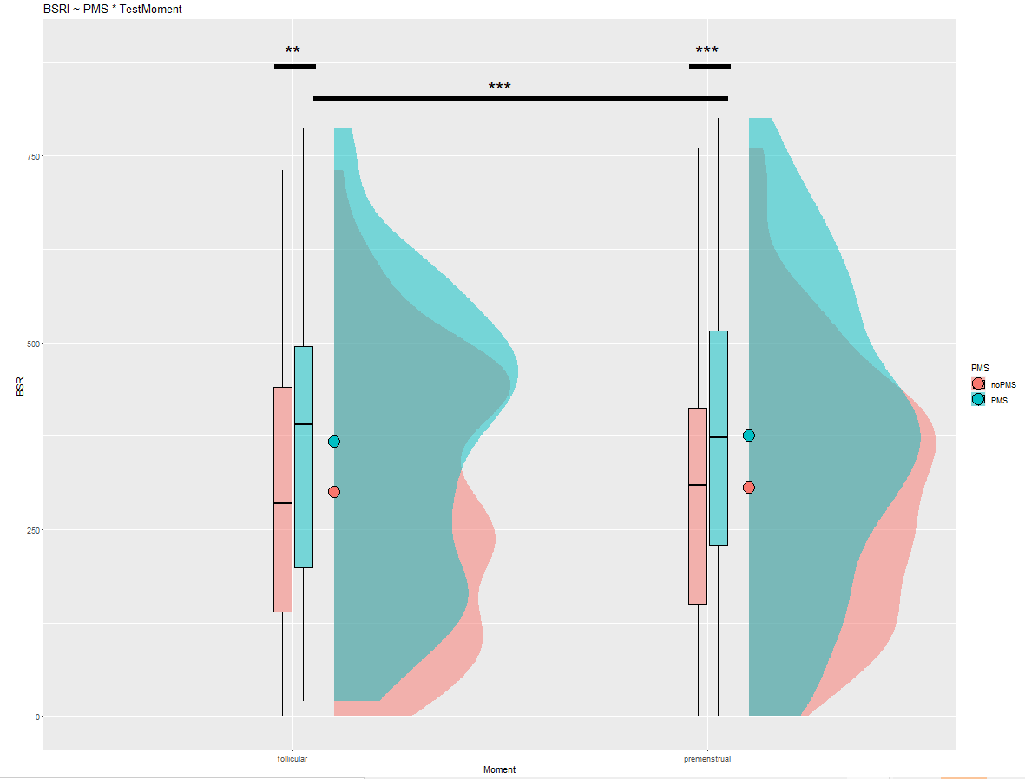
N=279
b= -17.27, SE=2.73, p-value <.0001
follicular luteal/premenstrual
Notes:
Even when controlling for testmoment. And we can also see that, again, people with PMS have higher rumination during the premenstrual phase.
b= -17.27, SE=2.73, p-value <.0001

Slide 21
IAPs IMAGES: Explicit measures
Notes:
Now, let’s look at the images the participants had to judge.

Slide 22
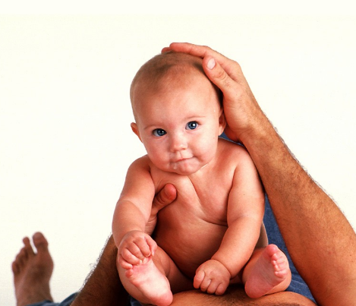
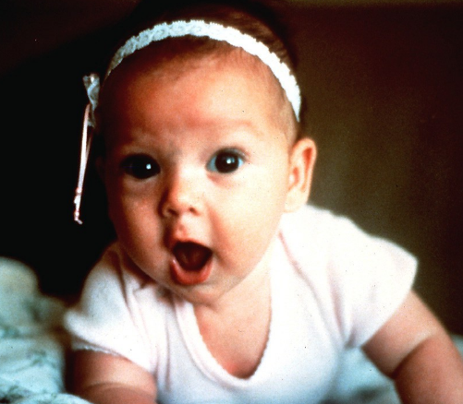
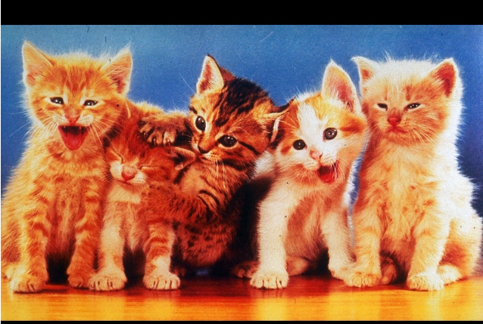
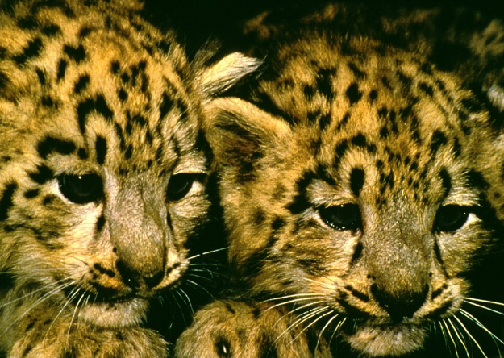
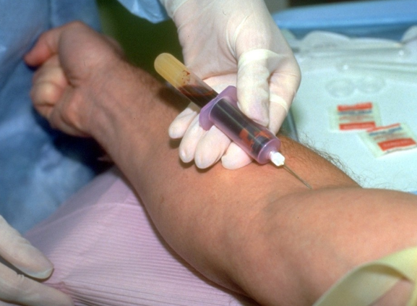
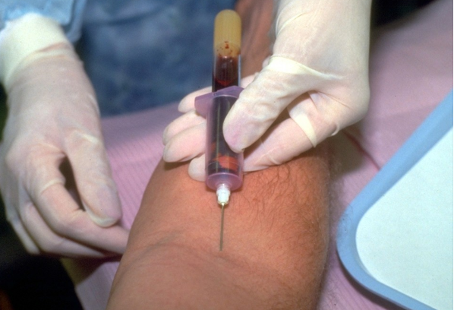
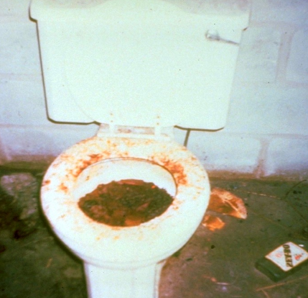
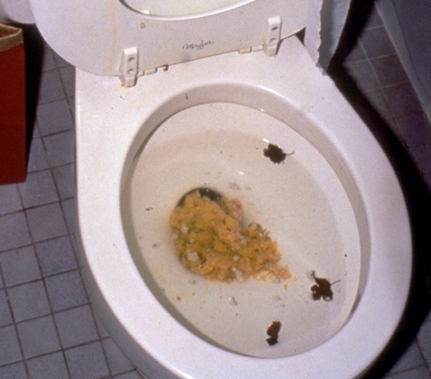
IAPs IMAGES
- Valence and Arousal
- Counterbalanced: image group A and B
Notes:
These were IAPs images which is a dataset of images that has already been thoroughly scored in the past. Participants could indicate how the images scored for them on Valence (upper row) and arousal (second row). There were two image groups, A and B, that were counterbalanced. So each image group would have for example a puppy, a scary image etc. The order was also counterbalanced, meaning some participants got A on the first testmoment, some got B.

Slide 23
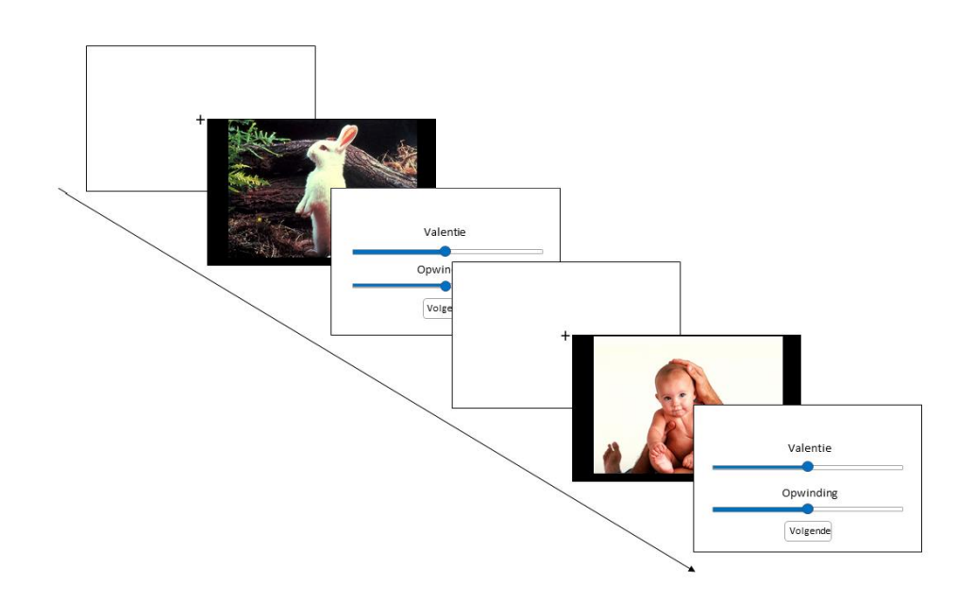
Fixation cross 3,000 ms
Picture for 6,000 ms
Continuous Valence and Arousal scales
Linthout, T. (2021). Emotion regulation during different phases of menstual cycle in healthy women and women with premenstrual suffering.

Slide 25
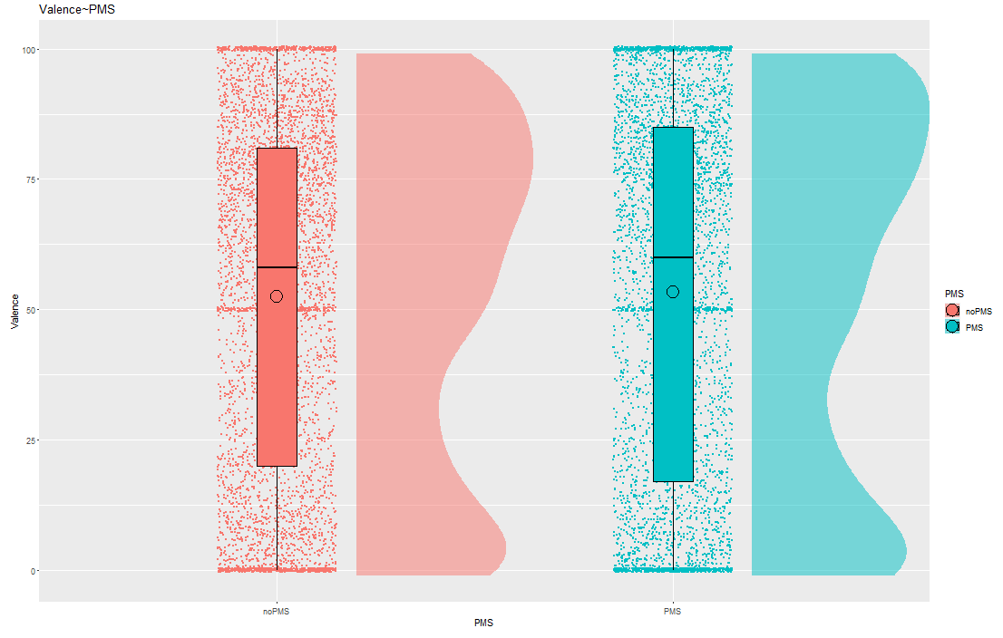
Valence
N=279
no PMS PMS
Notes:
We found that people with PMS rated the images higher on Arousal on average, but found no significant differences for Valence. When controlling for Testmoment we got the same results.

Slide 26
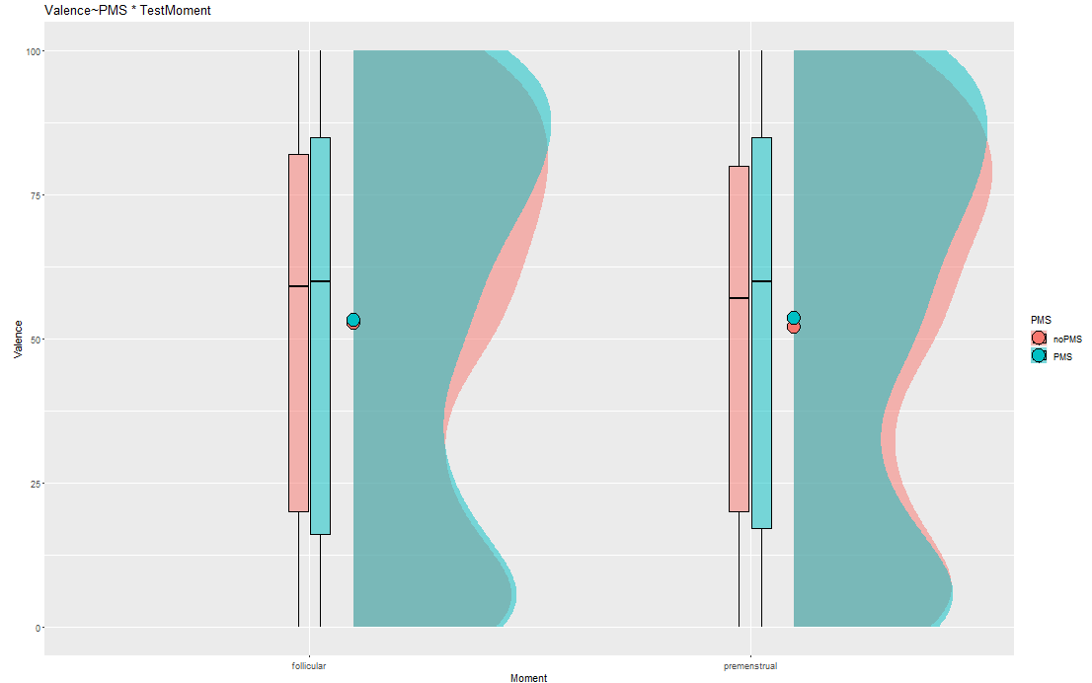
N=279
follicular luteal/premenstrual

Slide 27
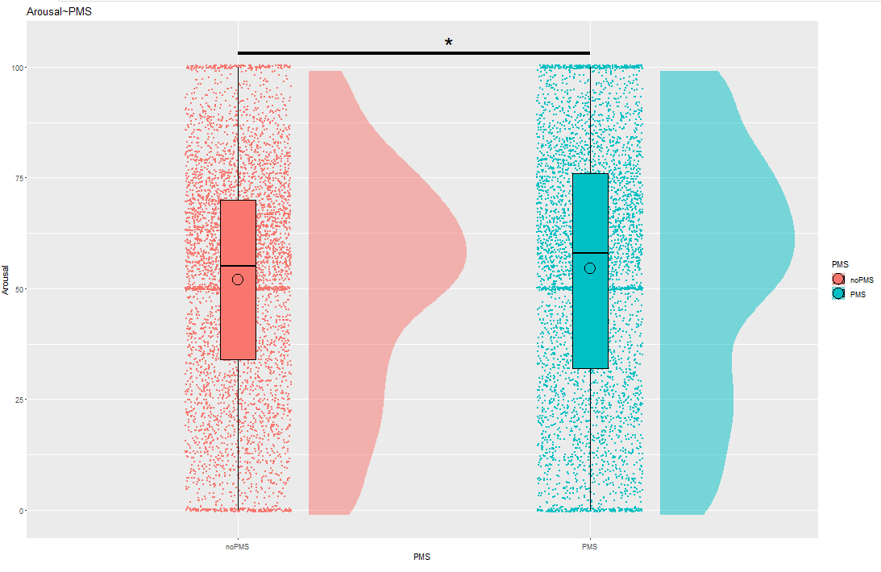
Arousal
N=279
b= -2.18, SE=0.89, p-value=0.014
no PMS PMS
Notes:
b= -2.18, SE=0.89, p-value=0.014

Slide 28
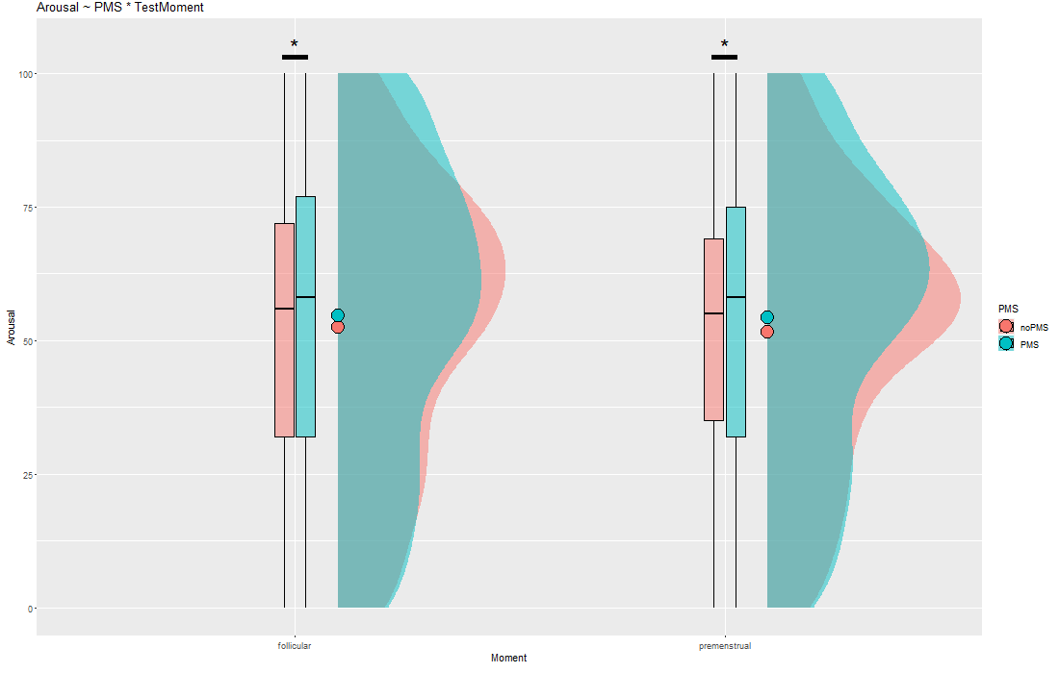
N=279
follicular luteal/premenstrual
Notes:
We find the same when controlling for TestMoment. However, we did not find a significant difference of the Arousal levels between follicular and premenstrual

Slide 29
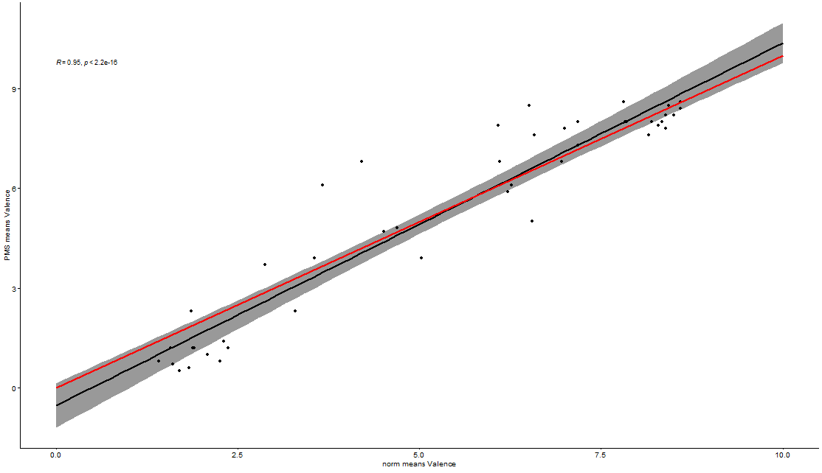
Correlation norms
norm means Valence

Slide 30
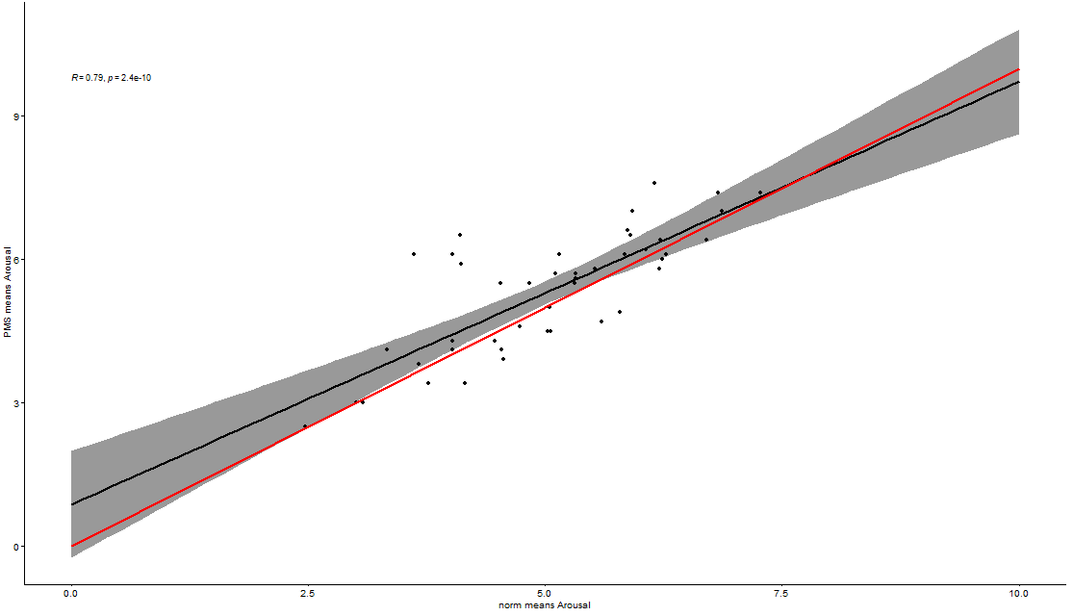
norm means Arousal

Slide 31
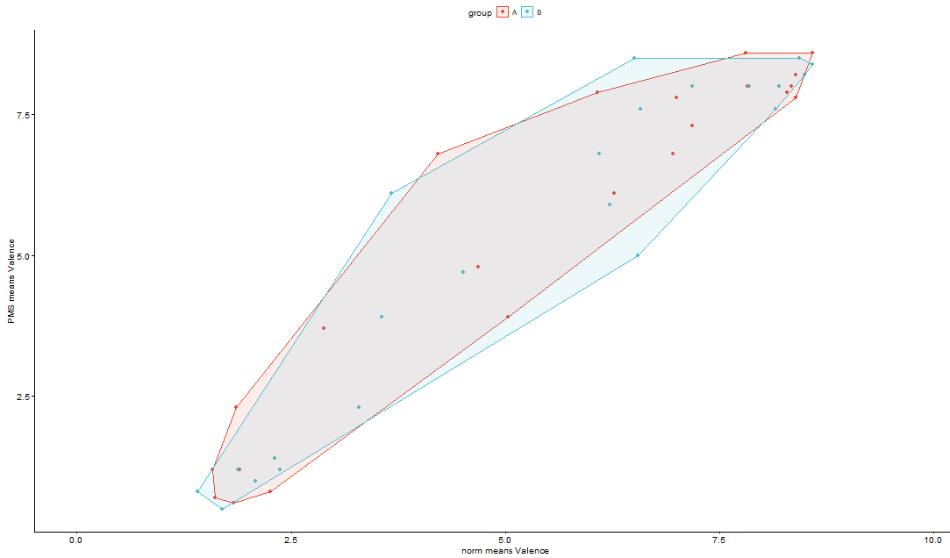
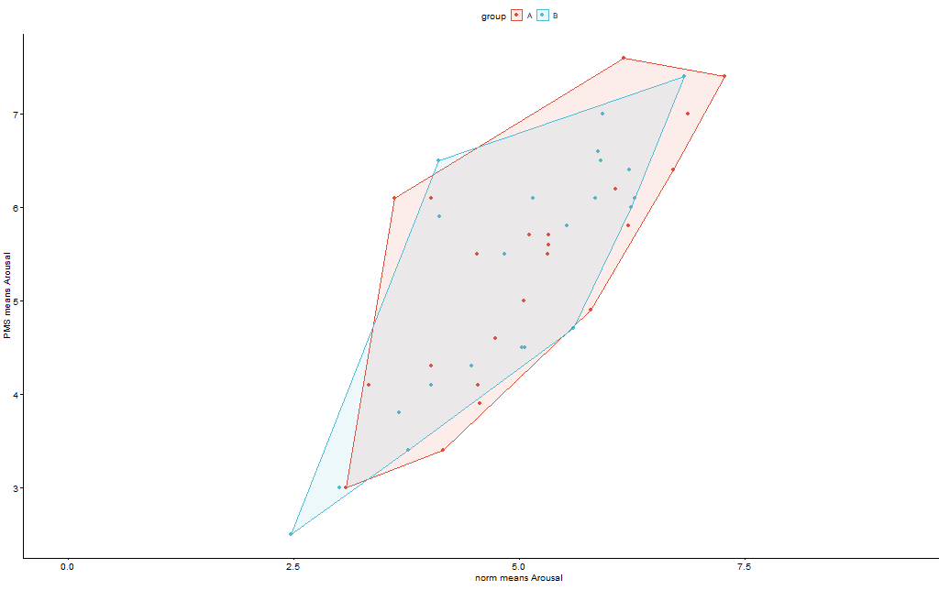
Image group A (red) vs B (blue)
X= norm means Valence/Arousal
Y= PMS means Valence/arousal
Notes:
We checked if there were differences between our study and the norms on these images in arousal and valence, and found high and significant correlations. We also did not find much differences between the image groups A and B.

Slide 32
Implicit measures: Emotional Expressions

Slide 33
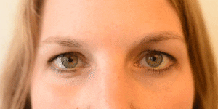
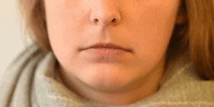
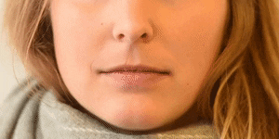
Facial Action Coding
Webcam would record participants as they judged the pictures
With OpenFace toolbox
Decode facial expressions based of facial action units
Less data: only confidence >.95 + some video’s bad quality/unconvertable
Notes:
https://imotions.com/blog/facial-action-coding-system/

Slide 34
AU12 | Lip Corner Puller
AU15 | Lip Corner Depressor
Happy | Cheek Raiser, Lip Corner Puller
Sad | Inner Brow Raiser, Brow Lowerer, Lip Corner Depressor
Disgust | Nose Wrinkler, Lip Corner Depressor, Lower Lip Depressor
Anger | Brow Lowerer, Upper Lid Raiser, Lid Tightener, Lip Tightener
scared | Inner Brow Raiser, Outer Brow Raiser, Brow Lowerer, Upper Lid Raiser, Lid Tightener, Lip Stretcher, Jaw Drop

Slide 35
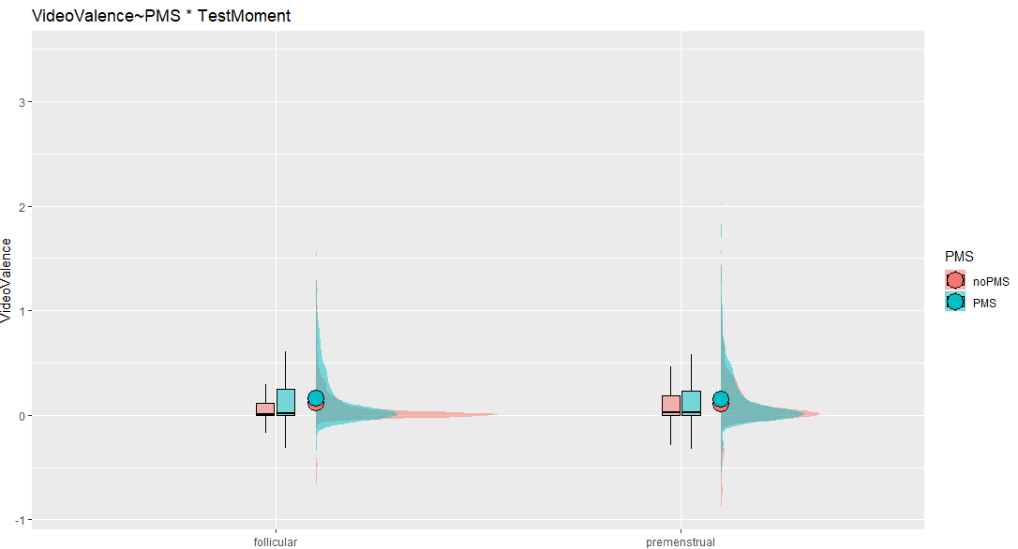
Valence

Slide 36
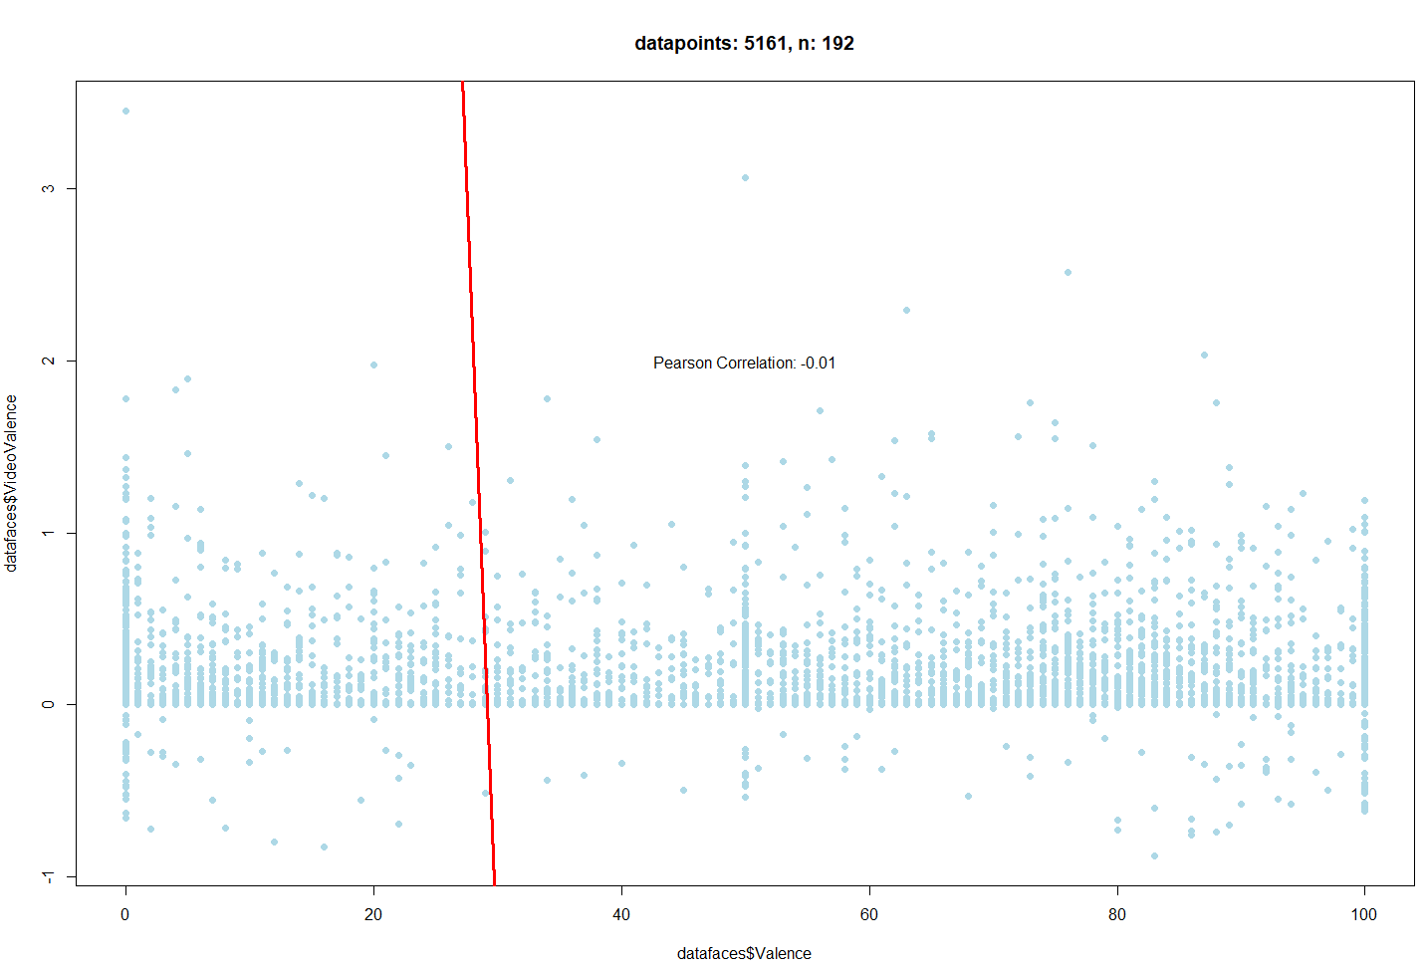

Slide 37
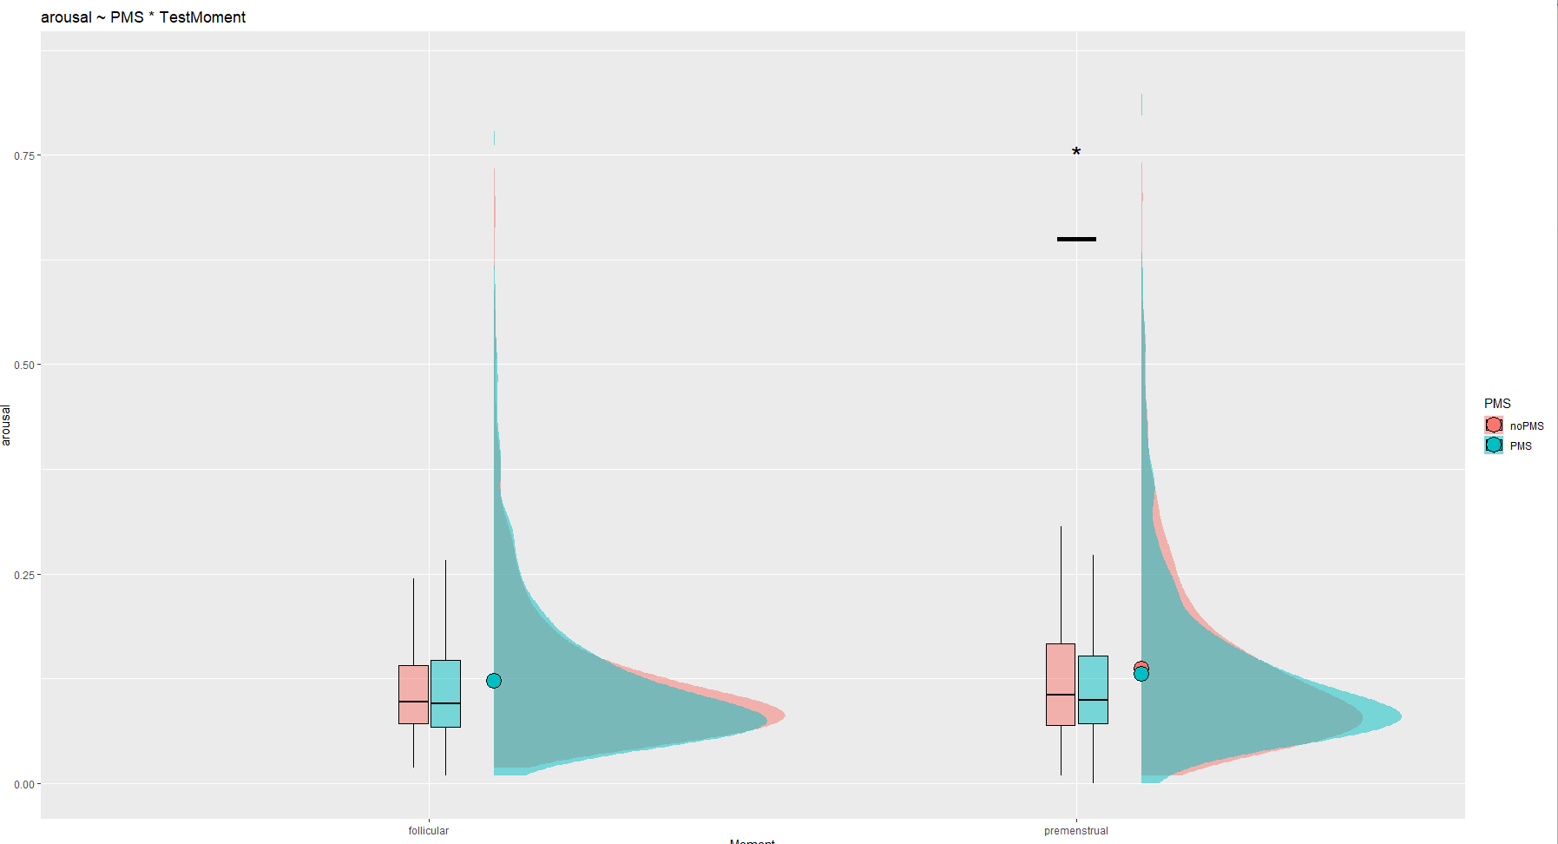
Arousal
b=-0.016, SE=0.005, p-value=0.002
Notes:
b=-0.016, SE=0.005, p-value=0.002

Slide 38
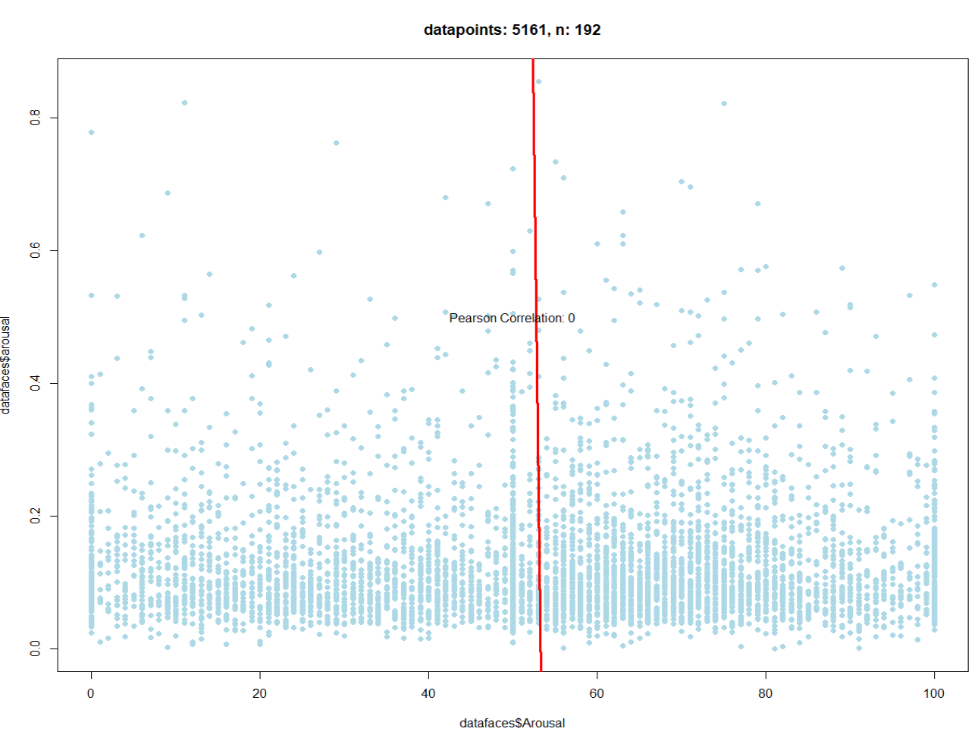

Slide 39
DASS

Slide 40
DASS
Depression, Anxiety, Stress
Trait, not state
Notes:
Then we looked at the DASS or Depression Anxiety Stress Scale. This is a trait measurement so we did not look at the effect of testmoment here, only at people with and without PMS.

Slide 41
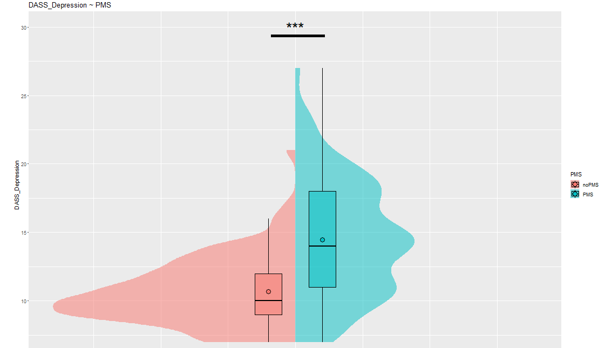
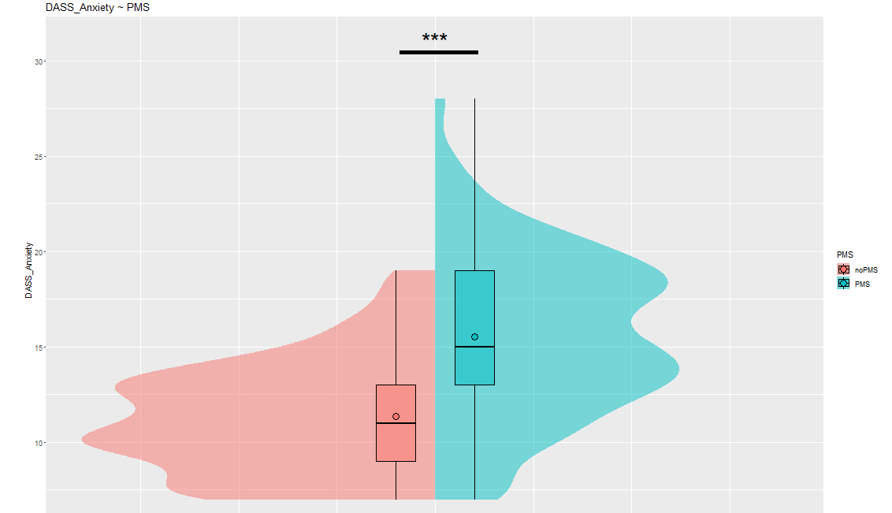
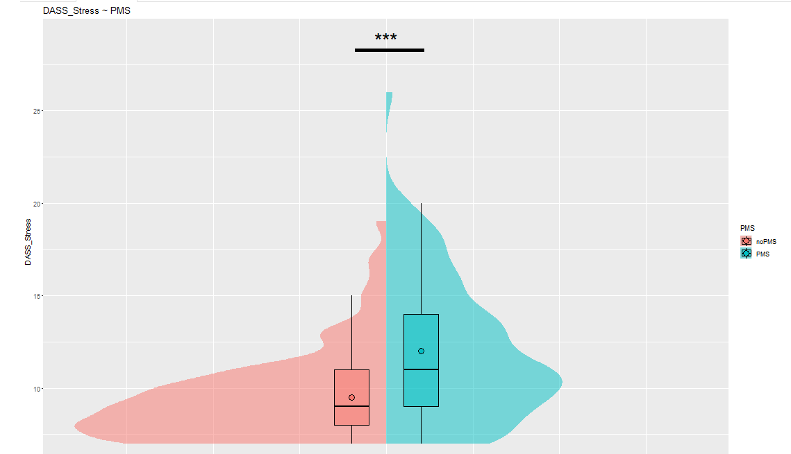
Notes:
Here, we see that people with PMS scored higher than people with low PMS scores on all 3 DASS Subscales.
Aggain, this is about a trait, not a state.

Slide 42
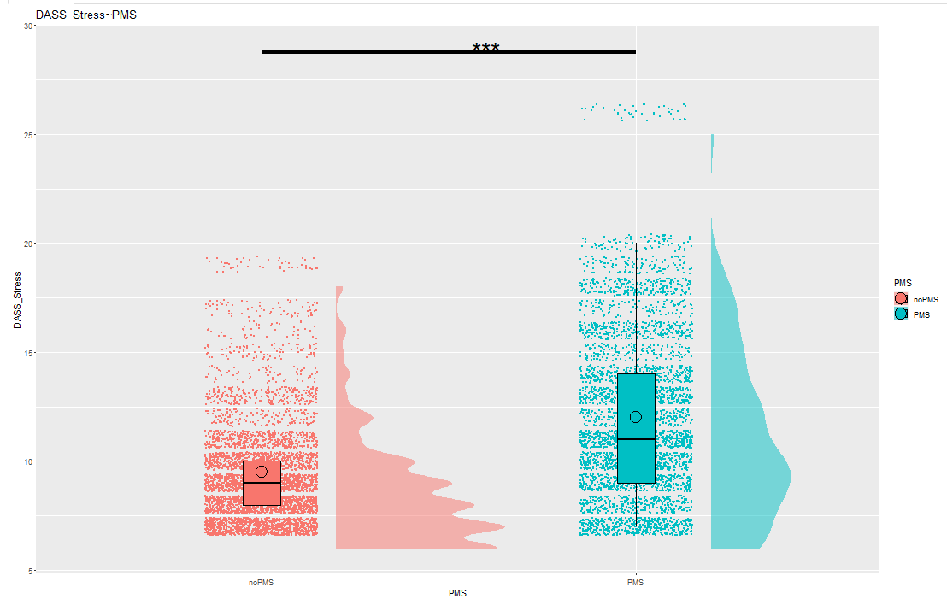
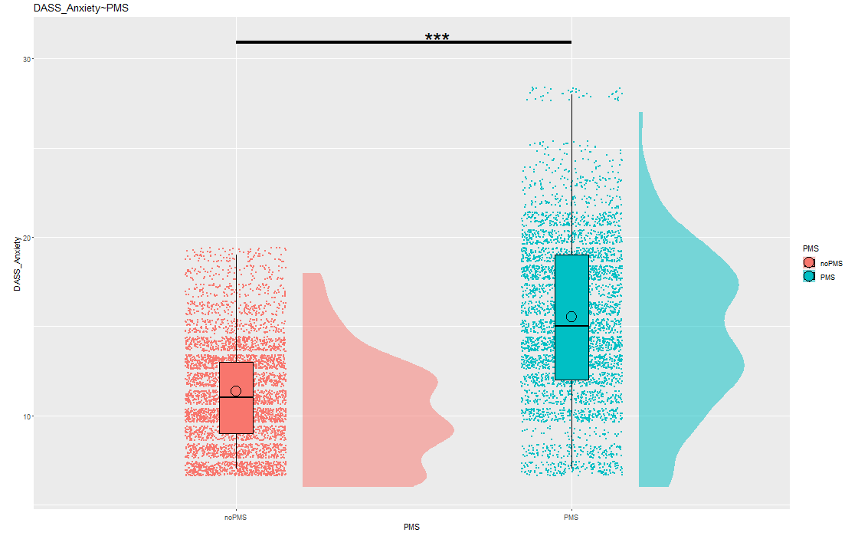
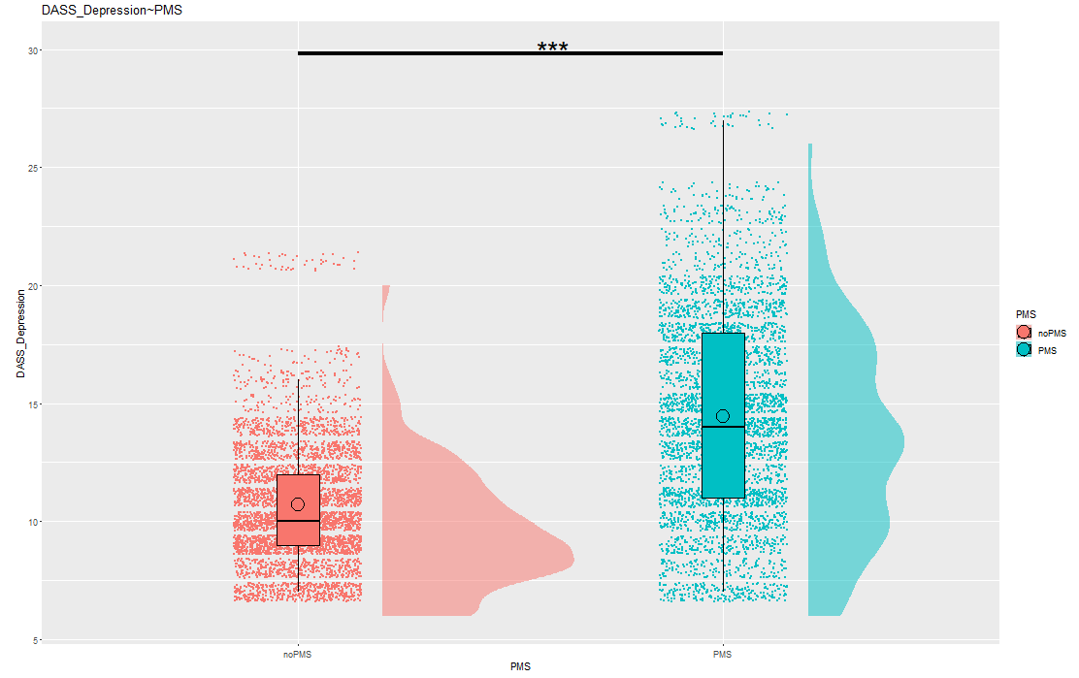

Slide 43




Sofie Raeymakers intern E sofie.raeymakersugent.be www.ugent.be
Universiteit Gent @ugent
@ugent Ghent University

